Slide 1
Modern Motors Service and Payroll Management System
Internal Guide: Mrs.V.Sujatha,
Head of the Department,
Computer Application
Sheetal Sreedhar
111918621346
Computer Application

Slide 2
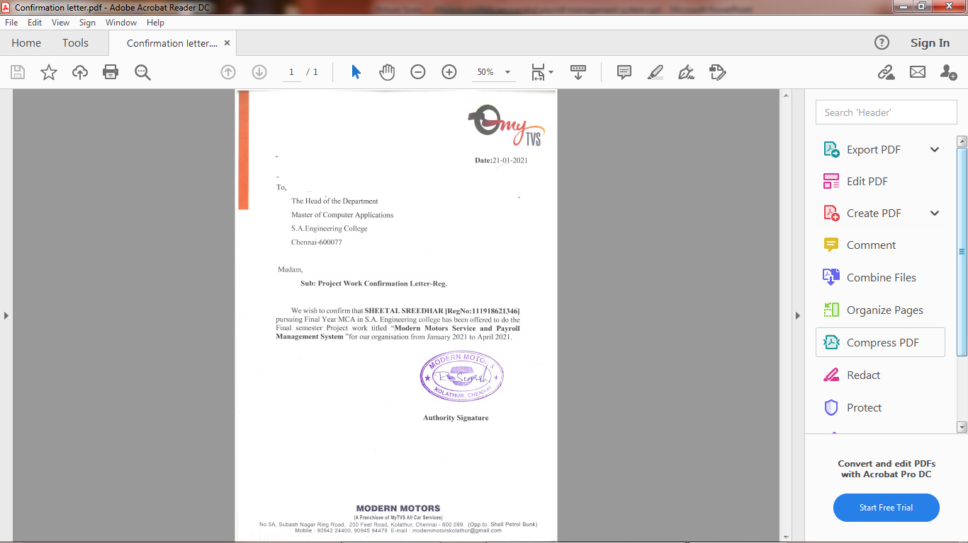
CONFIRMATION LETTER

Slide 3
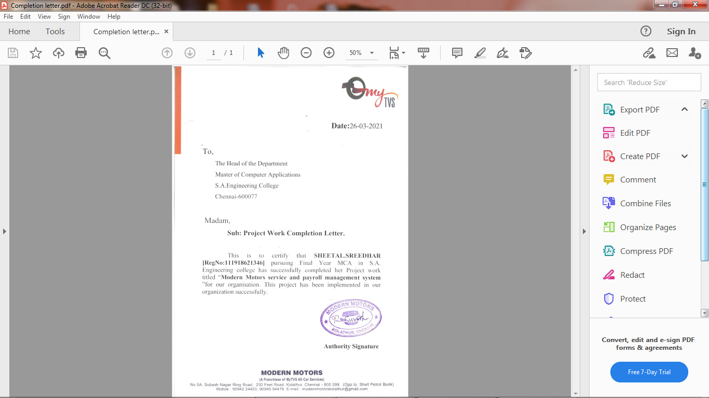
COMPLETION LETTER

Slide 4
ABSTRACT:
This Web application provides payroll processing for the employees in which the client can update employee details, salary, Timesheet and attendance .
It also provides service at the doorstep for customers after the customer book’s their required service and they are ready to checkout.
The customer receives a confirmation email of their service or products after their required purchase.
In this website we are selling products of car accessories such ah windshields, mirrors, indicators, lubricants…etc.
Each product has their own specific requirements.
If the customer wants to cancel the items, the items which they have purchased ,they can cancel their order and cansellation mail is send to the customers to their respective Mail-Id.

Slide 5
INTRODUCTION
Modern motors is a mechanical shop in which they provides services and sell products .
A web application is mainly used for submitting and retrieving the data from the database.
This application provides payroll processing for the customers by collecting the details of the employees and storing it.
The employee salary and their attendance sheet is maintained.
This application provides services for the customers in their requested date and time.
This application also sells products in car accessories such as universal parts.
The benefits of the application is that the client can easily maintain employee data and can keep a track of the products and their resourses.

Slide 6
SYSTEM SPECIFICATION
Hardware Requirements
RAM minimum 2GB.
Minimum Pentium-IV (Processor).
1MB Cache Memory – Optional
Hard disk 10 GB
Internet connection.
Software Requirements
Front end – HTML, Css, Java script(Notepad++)
Backend – PHP, MySql.
Web browse-Google chrome (or) Firefox.
Operating system-Windows7

Slide 7
EXISTING SYSTEM
SYSTEM ANALYSIS
In Modern motors if a customer needs a service he/she needs to go to a shop.
The customer details is not maintained properly, all details are maintained in a paper sheet.
Efficient amount of time is taken to maintain the accuracy of data.
The employee details and their salary wages is maintained in a book which is not preserved in an accurate manner.
DEMIRITS
Manual entry
Time consuming
Time delay in response

Slide 8
PROPOSED SYSTEM
Provides payroll processing for the employees.
Provides services for the customer.
1. Periodic services
2. Denting and painting
3. Car spa and cleaning
Provides stock inventory in car accessories such as mirrors, lubricants…etc.
Builds stronger relationship with the customers.
An email is sent to the customers after purchasing their items.
No time delay in response i.e if the customer wants to know any details of the products or services , they can ask any queries in contact us form.
Cash on delivery is available for the customers after purchasing their products.
If the customer cancel their products ,a cancellation email is send to their perspective mail-id.
ADVANTAGES
Cost effective and time saving.
The services are given at the doorstep so the customers no need to go to the shop

Slide 9
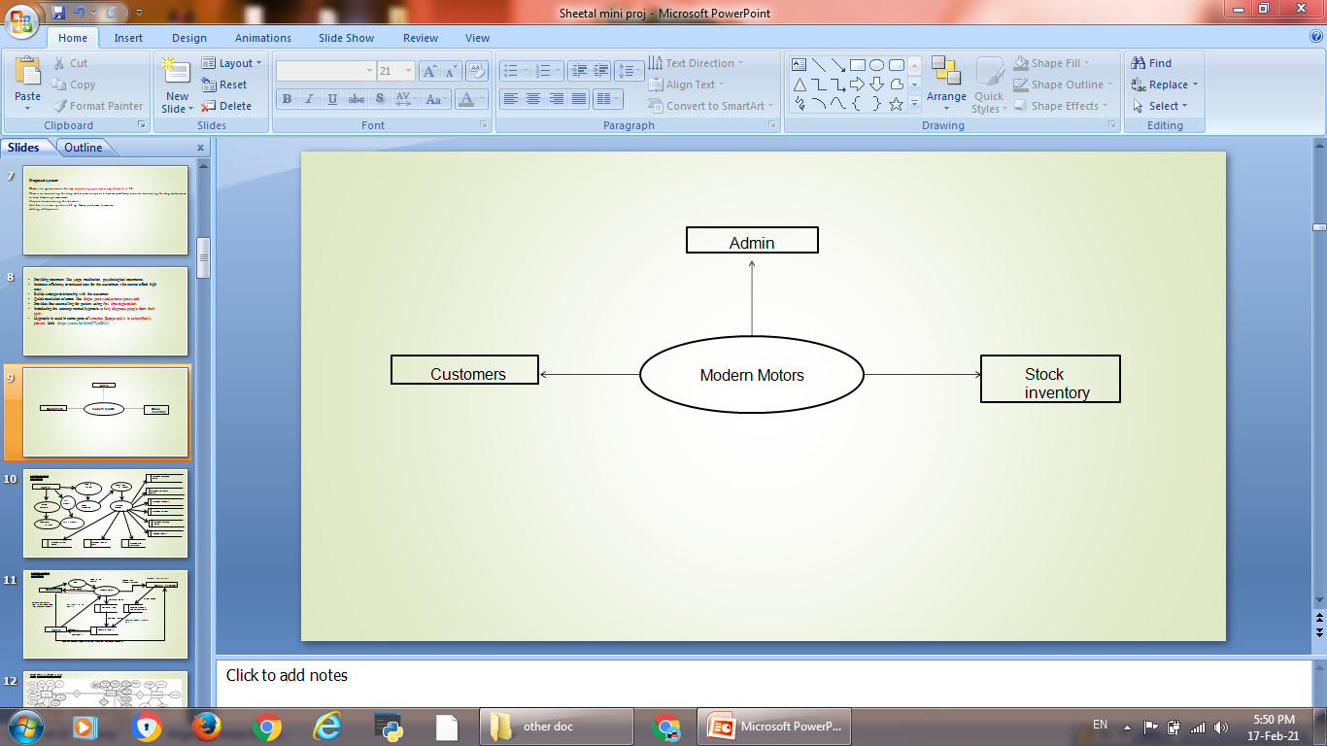
CONTEXT ANALYSIS DIAGRAM
ZERO LEVEL DFD

Slide 10
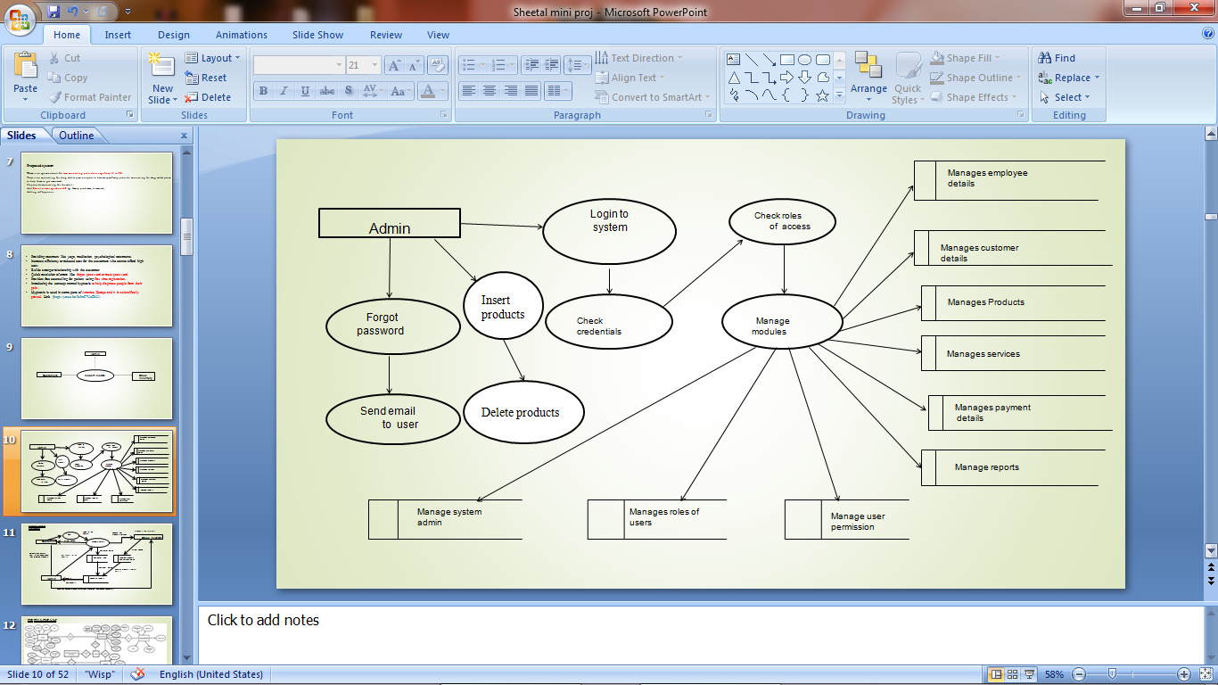
LEVEL 1 DFD:

Slide 11
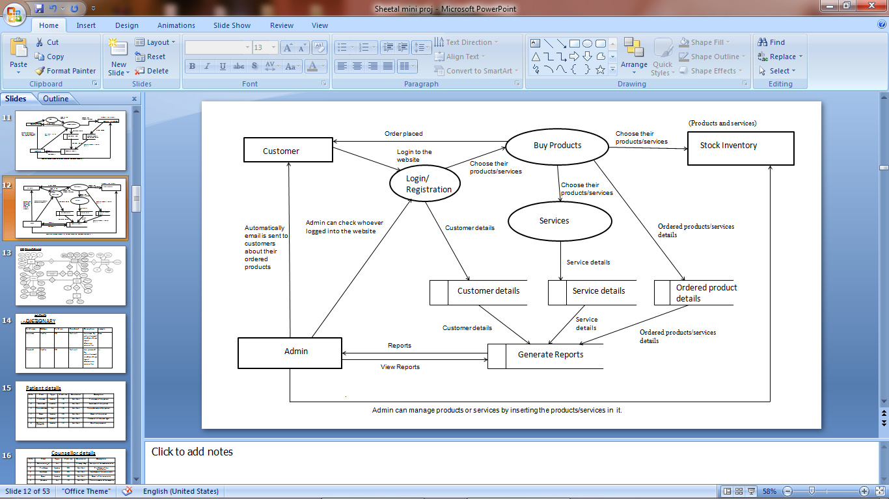
LEVEL 2 DFD:

Slide 12
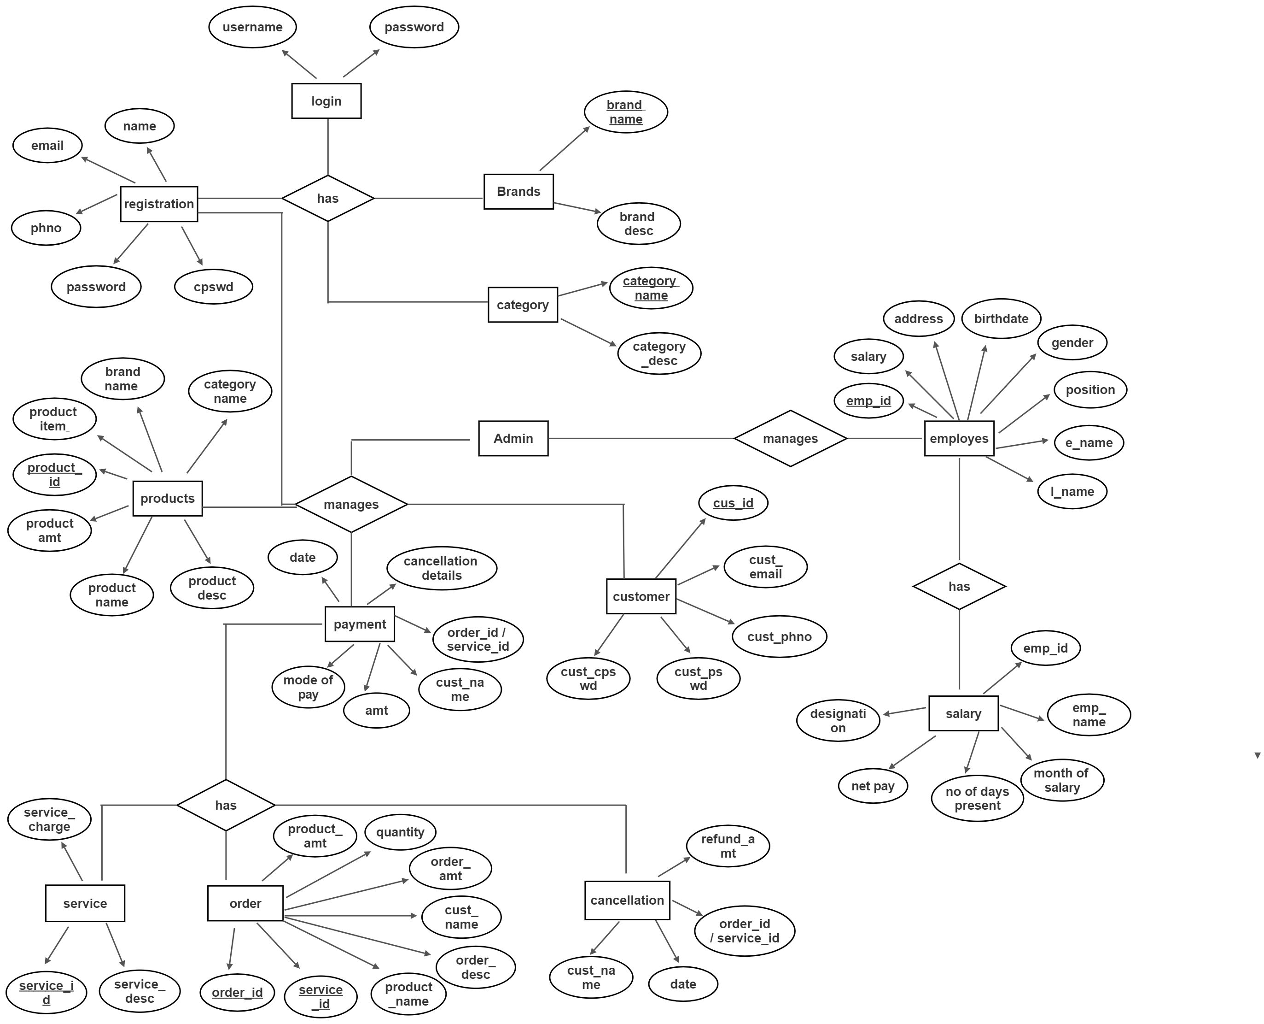
ER Diagram

Slide 13
Data dictionary
Login table
Field name | Datatype | Field size | Constraint | Description
Username | Varchar | 20 | Not null | Username used by customers
Password | Varchar | 20 | Not null | password used by customers

Slide 14
Customer details
Field name | Datatype | Field size | Constraint | Description
Cust_Id | Int | 10 | Primary key | Id of the customer
Cust_name | Varchar | 10 | Primary key | Name of the customer
Cust_email | Varchar | 30 | Not null | Email of the customer
Cust_phno | Varchar | 10 | Not null | Phonenumber of the customer
Cust_pswd | Varchar | 10 | Not null | Password of the customer
Cust_cpswd | Varchar | 10 | Not null | Confirmpassword of the customer

Slide 15
Product details
Field name | Datatype | Field size | Constraint | Description
Product_id | Int | 10 | Primary key | Id of the Product
Category name | Varchar | 20 | Foreign key | Name of the product category
Brand name | Varchar | 20 | Foreign key | Brand name of the product
Product name | Varchar | 20 | Not null | Name of the product
Product amt | Int | 30 | Not null | Amount of the product
Product items | Varchar | 20 | Not null | Items of the product
Product desc | Varchar | 50 | Not null | Description of the product

Slide 16
Brand details
Field name | Datatype | Field size | Constraint | Description
Brand name | varchar | 10 | Primary key | Name of the brand
Brand desc | varchar | 50 | Not null | Description of the brand
Category details
Field name | Datatype | Field size | Constraint | Description
Category name | varchar | 10 | Primary key | Name of the category
Category desc | varchar | 50 | Not null | Description of the category

Slide 17
Order details
Field name | Datatype | Field size | Constraint | Description
Order_id | Int | 10 | Primary key | Id of the order
Service_id | Int | 10 | Primary key | Id of the service
Product_name | Varchar | 10 | Not null | Name of the product
Product_amt | Varchar | 50 | Not null | Amt of the product
Quantity | Int | 10 | Not null | Quantity of products
Order_amt | Int | 10 | Not null | Amount of the order
Cust_name | Varchar | 10 | Not null | Name of the customer
Order_desc | Varchar | 50 | Not null | Description of the order

Slide 18
Service details
Field name | Datatype | Field size | Constraint | Description
Service_id | Int | 10 | Primary key | Id of the service
Service_desc | Varchar | 50 | Not null | Description of the service
Service_charge | Int | 10 | Not null | Amount to be payed for the service

Slide 19
Payment details
Field name | Datatype | Field size | Constraint | Description
Order_id/Service_id | Int | 10 | Foreign key | The id of the order
Cust_name | Varchar | 10 | Foreign key | Name of the customer
Amount | Int | 20 | Not null | Amount to be payed by the customer
Mode of pay | Varchar | 10 | Not null | Mode of payment
Date | date | 10 | Not null | Date of payment

Slide 20
Cancellation details
Field name | Datatype | Field size | Constraint | Description
Order_id/Service_id | Int | 10 | Foreign key | The id of the order
Cust_name | Varchar | 10 | Foreign key | Name of the customer
Date | date | 10 | Not null | Date of payment
Refund Amount | Int | 20 | Not null | Amount to be refunded

Slide 21
Employee details
Field name | Datatype | Field size | Constraint | Description
Emp_id | Int | 10 | Primary key | Id of the employee
First_name | Varchar | 10 | Not null | First name of the employee
Last_name | Varchar | 10 | Not null | Last name of the employee
DOB | Date | 10 | Not null | Date of birth
Address | Varchar | 30 | Not null | Present Address of the employee
Gender | Varchar | 10 | Not null | Gender of the employee
Position | Varchar | 10 | Not null | Position mentioned for the employee
Schedule | Varchar | 10 | Not null | Schedule of the employee
Salary | Int | 20 | Not null | Salary of the employees

Slide 22
Salary details of Employee
Field name | Datatype | Field size | Constraint | Description
Emp_id | Int | 10 | Foreign key | Id of the employee
Emp_name | Varchar | 10 | Not null | Name of the employee
Designation | Varchar | 10 | Not null | Designation of the employee
Net pay | Int | 20 | Not null | How much of the amount taken divided by 30
Month of salary | Int | 20 | Not null | Month the salary is distributed
No of days present | Int | 30 | Not null | No of days present by the employee

Slide 23
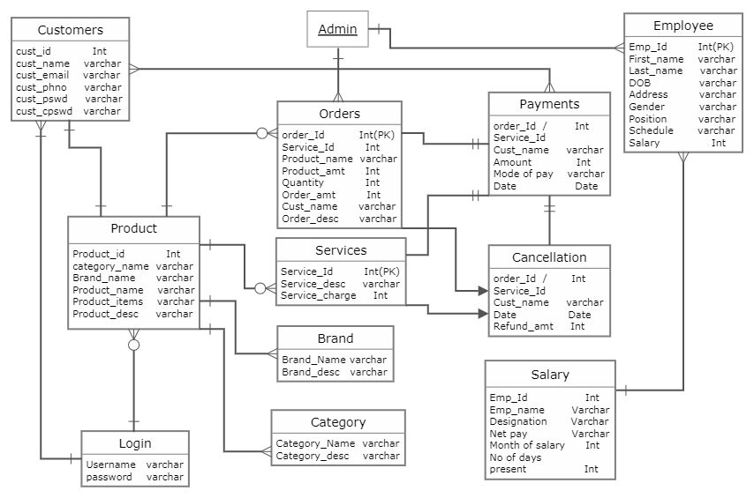
TABLE RELATIONSHIP

Slide 24
Modular description:
ADMIN:
Manages login details
Manages user permission
Manages and track notification system
Manages all the other details(Customer details, employee details...etc)
CUSTOMER REGISTRATION:
A customer needs to give the registration details such as (name,email,phno,pswd,cpswd).
After registering they are asked to login to the website.
Then they can purchase or order the required items or services.

Slide 25
PRODUCT MODULE:
A product module has brand name and category name which is used for creating a product category and inserting the products into it
Each product has its own specifications, price and descriptions.
After inserting a product which is done through admin panel , it is asked to upload the images of the products.
The products will be displayed in the website with the category name and its descriptions.
CATEGORY MODULE:
A category module contains category name and description.
Each category has also a subcategory which is used for inserting the products.
BRAND MODULE:
A brand module contains brand name and description.
Each brand name represents the product brand and their items.

Slide 26
ORDER DETAILS MODULE:
After the customer purchase the items their order ID and their Product name would be shown in order history.
The customer can also track their order with their order ID.
SERVICE DETAILS MODULE:
After the customer purchase for the required service , their service ID would be shown in order history.
The customer will receive service at the date and time they have mentioned.
PAYMENT MODULE:
The customer will be directed to Razor-pay after they proceed to checkout their order or service.
The customer needs to enter their card details, their email and phone-no.
Date of payment will be mentioned.
CANCELLATION:
If the customer needs to cancel the order or service , they can cancel their order/service underneath the placed order/service which will be mentioned.
After the customer cancel their order/service they will receive a Cancellation Mail.

Slide 27
EMPLOYEE MODULE:
Employee details will be managed in the admin side.
For Each employee an Emp_Id is created
The admin will enter all the employee details.
After entering the details employee id will be generated.
The employee must enter the employee id in which time they come and in which time they leave.
The employee’s salary , deduction, net-pay and gross pay will be calculated.
SALARY DETAILS OF EMPLOYEE:
For salary details the employee’s Emp_id, Emp_name and their designation is collected.
Net pay is calculated according to the salary which they earn and is lessed by No of days they were not present.
Month of salary in which date they have received.
No of days they have been present will also be noted.

Slide 28
TESTING:
Software testing is an investigation conducted to provide stakeholder with information about the quality of the software product or services under test. Software testing can also provide an objective, independent view of the software to allow the business to appreciate and understand the risk of software implementation. Test techniques include the process of executing a program or application with the intent of finding software bugs (error or other defects), and verifying that the software product is fit for use.
OBJECTIVES OF TESTING:
Testing is a process of executing a program with intent of finding an error.
A good test case is one that has a right probability of finding an as yet undiscovered error.
A successful test is one that uncover an as yet undiscovered error.
Objectives tests are measures in which responses maximize objectivity, in the sense that response options are structured such that examinees have only a limited set of options. Structuring a measure in this way is intended to minimize subjectivity or bias on the part of the individual administering the measure so that administering and interpreting the result does not rely on the judgment of the examiner.

Slide 29
TESTING PLAN:
Analyse the product
Design the test strategy
Define the test objectives
Define test criteria
Resources planning
Plan test environment
Schedule & estimation
Determining test deliverables

Slide 30
TYPES OF TESTING:
Unit testing
Integration testing
Functional testing
Validation testing

Slide 31
UNIT TESTING:
Unit testing is a software development process that involves a synchronizes application of a broad spectrum of defect prevention and detection in order to reduce software development risk, time, and costs. It is performed by the software developer or engineer during the construction phase of the software development lifecycle.
Unit testing aims to eliminate construction error before code is promoted to additional testing; this strategy is intended to increase the quality of the resulting software as well as the efficiency of the overall development process. Depending on the organization’s expectations for software development, unit testing might include static code analysis, data-flow analysis, metrics analysis, peer code reviews, code coverage analysis and other software testing practices.
FUNCTIONAL TESTING:
Functional testing is a quality assurance (QA) process and a type of black-box testing that bases its test cases on the specifications of the software component under test.
Functions are tested by feeding them input and examining the output, and internal program structure is rarely considered (unlike white-box testing) . Functional testing usually describe what the system dose.

Slide 32
Three types of tests in functional test:
Performances testing
Stress testing
Structural testing
PERFORMANCE TESTING:
A performance testing is a form of software testing that focuses on how a system running the system performs under a particular load. This is not about finding software bugs or defects. Performance testing measure according to benchmarks and standards. Performances testing should give developers the diagnostic information they need to eliminate bottleneck.
STRESS TESTING:
Unlike load testing, stress testing also known as fatigue testing is meant to measure system performances outside of the parameters of normal working conditions. The software is given more users or transactions that can be handled. The goal of stress testing is to measure software stability.

Slide 33
STRUCTURAL TESTING:
Structural testing, also known as glass box testing or white box testing is an approach where the test are derived from the knowledge of the software’s structure or internal implementation.
The other name of structural testing includes clear box testing, open box testing, logic driven testing or path driven testing.
STRUCTURAL TESTING TECHNIQUES:
Statement coverage- This technique is aimed at exercising all programming statement with minimal tests.
Branch coverage- This technique is running a serial of tests to ensure that all branches are testing at least once.
Path testing: These techniques correspond to testing all possible paths which means that ensures statement and branches are covered.
VALIDATION TESTING:
Validation testing can be best demonstrated using V-model. The software product under test is evaluated during this type of testing. Validation testing ensures that the product actually meet the client’s needs.

Slide 34
UNIT TESTING:
TEST NO | TEST TYPE | TEST INPUT | EXPECTED OUTPUT | ACTUAL OUTPUT | RESULT
1 | Unit Testing | Enter the name in character | The character should be displayed | Displays the character | Success
 |  | Enter the name in numeric | The character should be displayed | Displays the number | Failure
2 | Unit Testing | Enter the password | The password should display | Displays the password | Success
 |  | Enter password | The password should display | Mismatch password | Failure

Slide 35
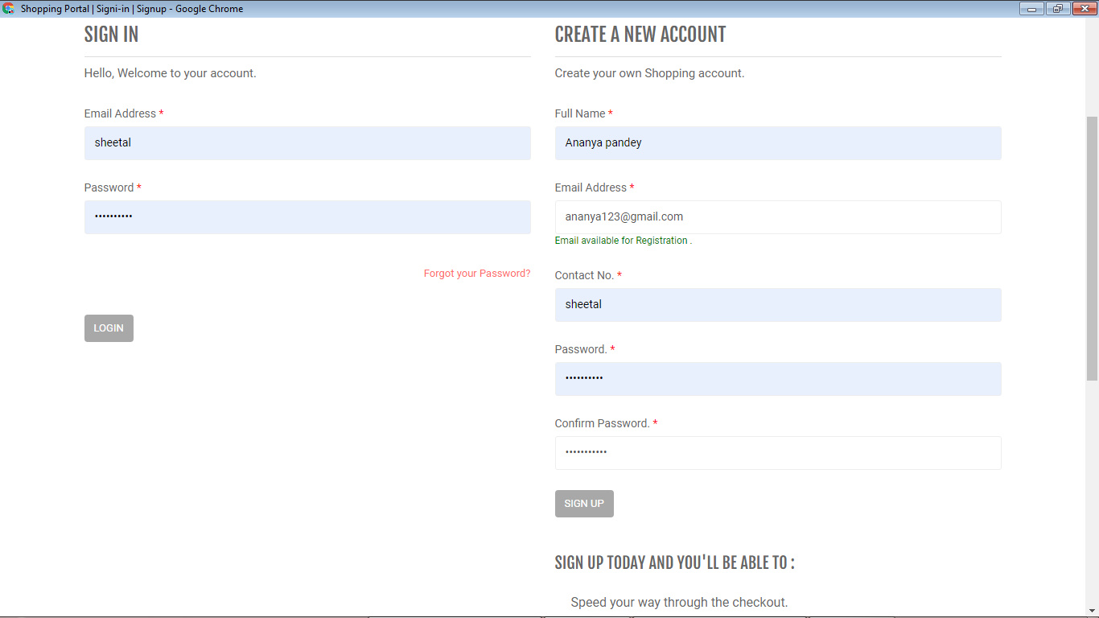
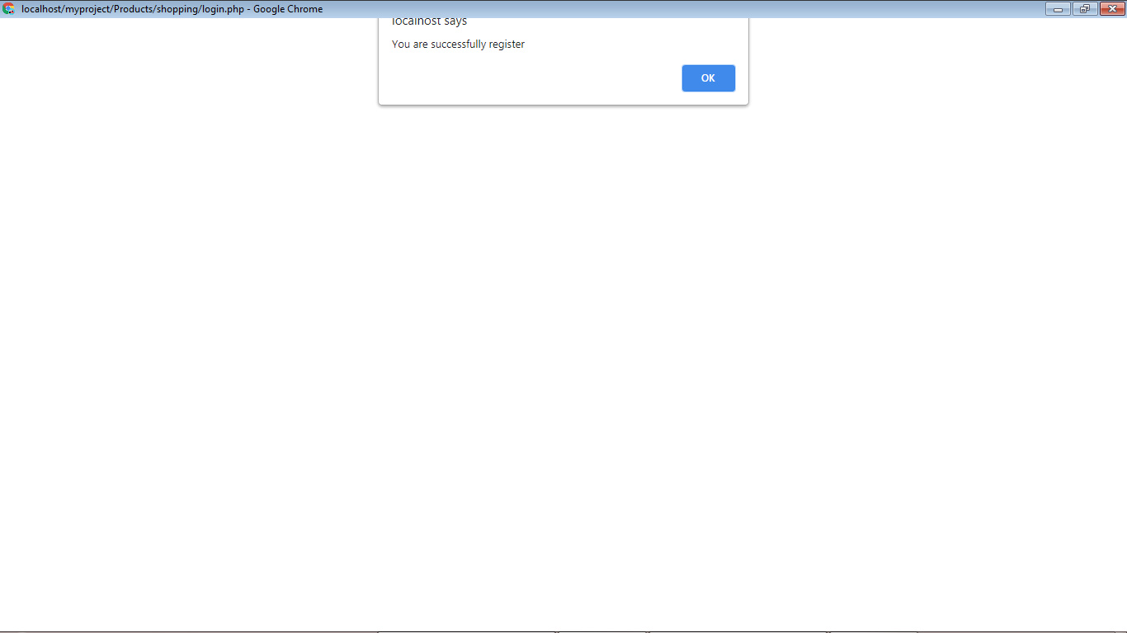
UNIT TESTING:
TEST CASE SUCCESS:

Slide 36
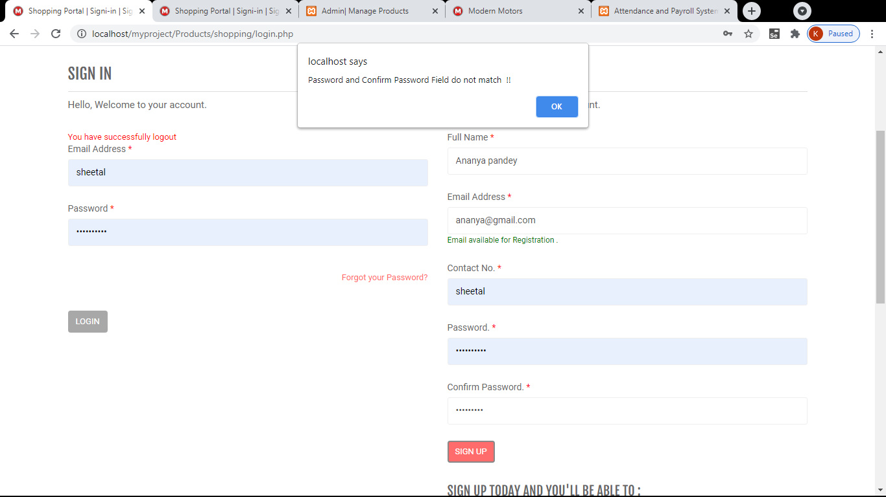
UNIT TESTING:
TESTCASE FAILURE:

Slide 37
INTEGRATION TESTING:
Integration testing is a systematic technique for construction the program structure while at the same time conducting tests to uncover errors associated with interfacing. i.e., integration testing is the complete testing of the set of modules which makes up the product. The objective is to take untested modules and build a program structure tester should identify critical modules. Critical modules should be tested as early as possible. One approach is to wait until all the units have passed testing, and then combine them and then tested.
TEST NO | TEST TYPE | TEST INPUT | EXPECTED OUTPUT | ACTUAL OUTPUT | RESULT
1 | Integration testing | Enter new Employee details | Details inserted into the record | Inserted successfully | Success
2 | Integration testing | Enter new Employee details | Details inserted into the record | Enter all the fields | Failure

Slide 38
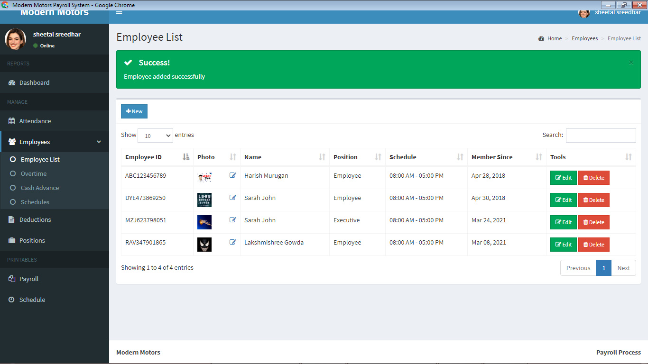
INTEGRATION TESTING:
TEST CASE SUCCESS:

Slide 39
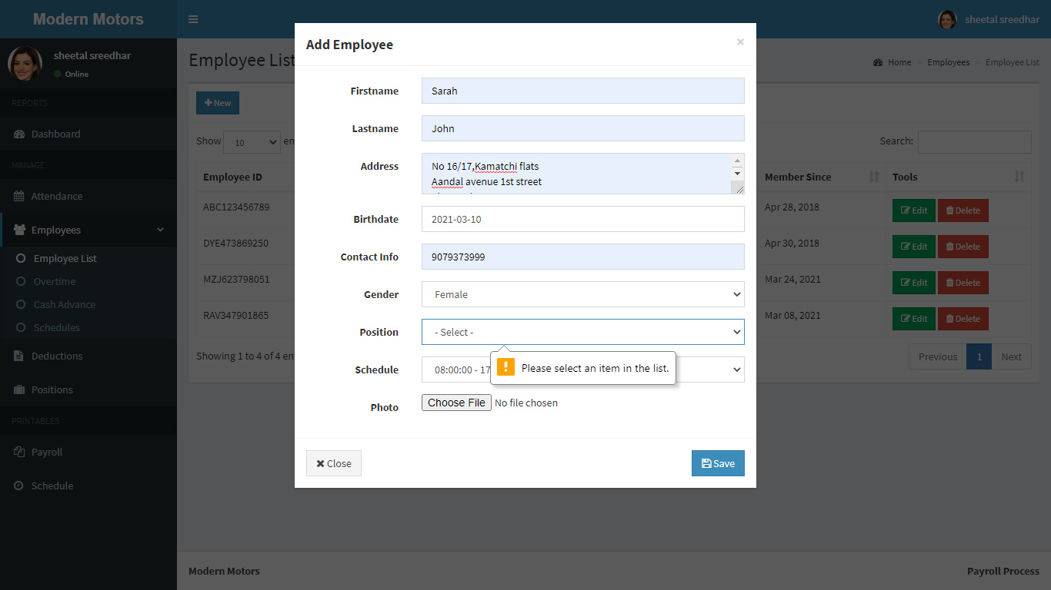
INTEGRATION TESTING:
TEST CASE FAILURE:

Slide 40
VALIDATION TESTING:
TEST NO | TEST TYPE | TEST INPUT | EXPECTED OUTPUT | ACTUAL OUTPUT | RESULT
1 | Validation testing | Enter the username and password | Allowed any username and password if it satisfies the constraint | Login successfully | Success
2 | Validation testing | Enter the username and password | Allowed any username and password if it not satisfies the constraint | Invalid login | Failure

Slide 41
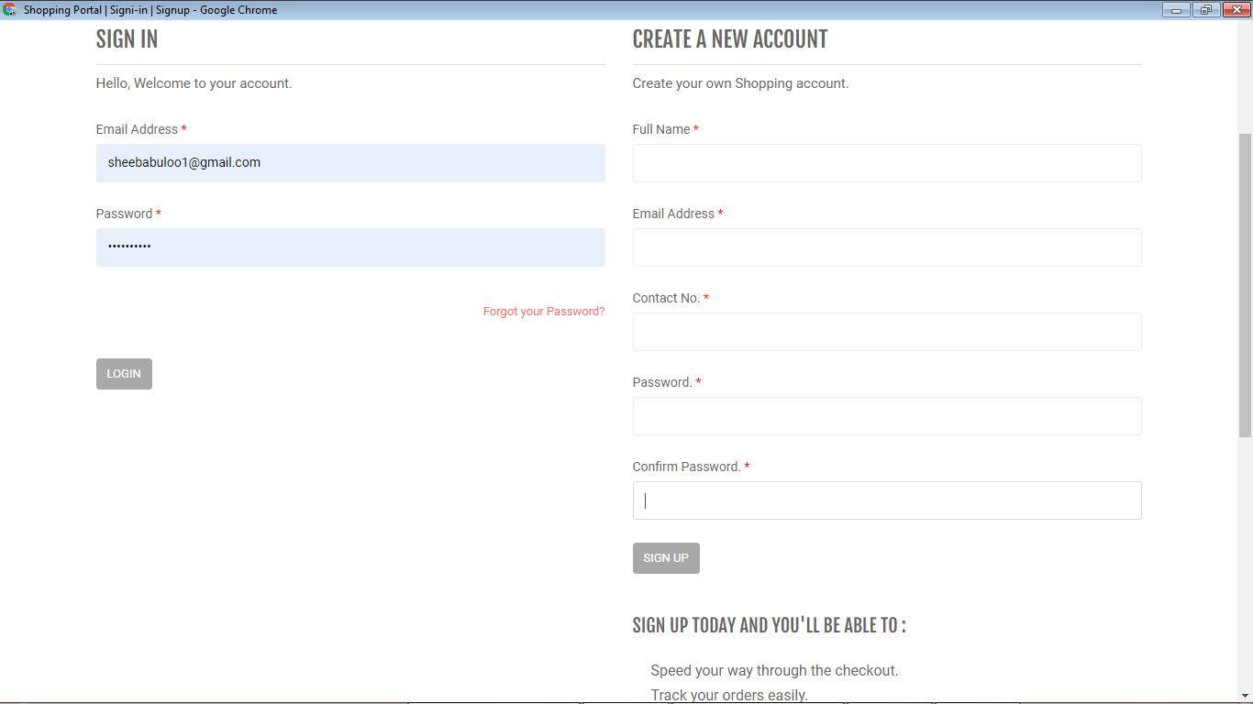
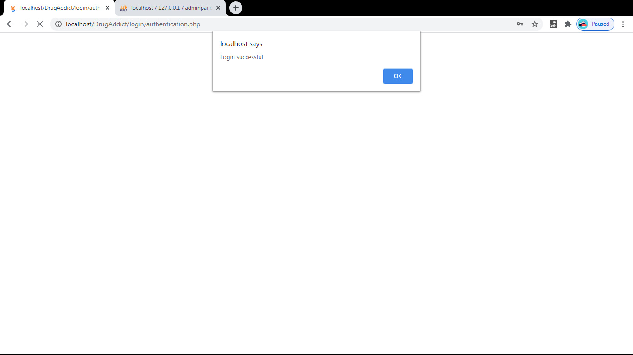
VALIDATION TESTING:
TEST CASE SUCCESS:

Slide 42
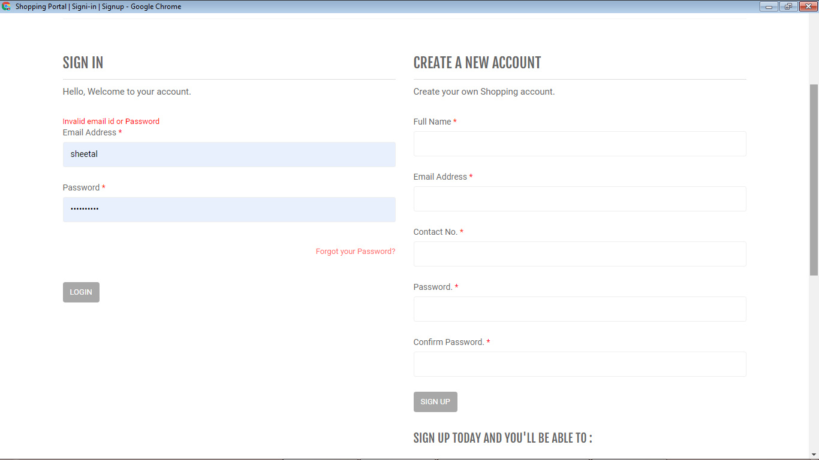
VALIDATION TESTING:
TEST CASE FAILURE:

Slide 43
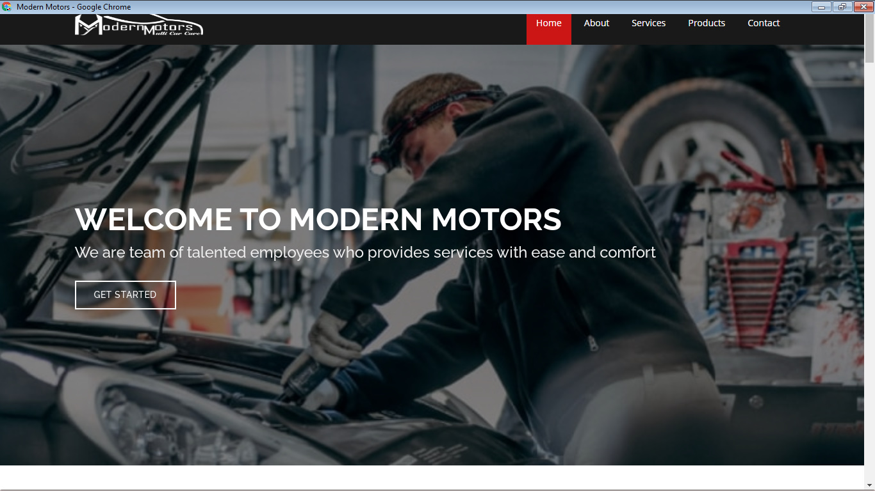
SAMPLE SCREENSHOT:
HOME SCREEN:

Slide 44
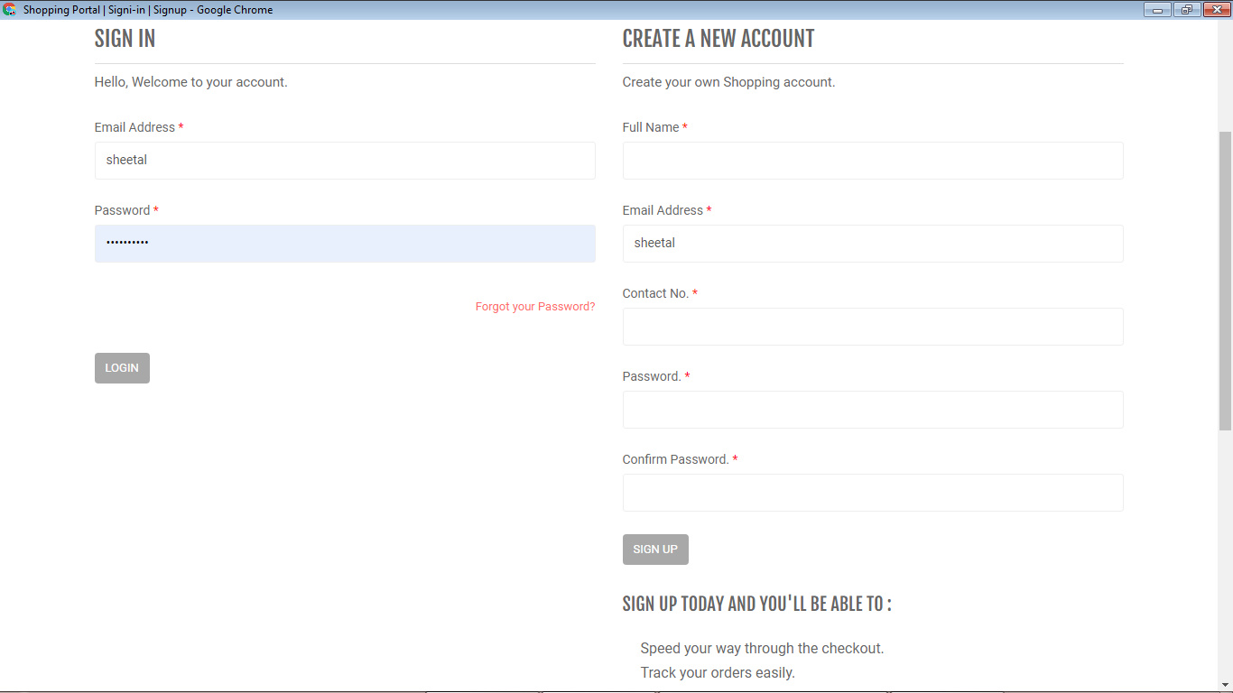
CUSTOMER SIGNIN AND SIGNUP PAGE:

Slide 45
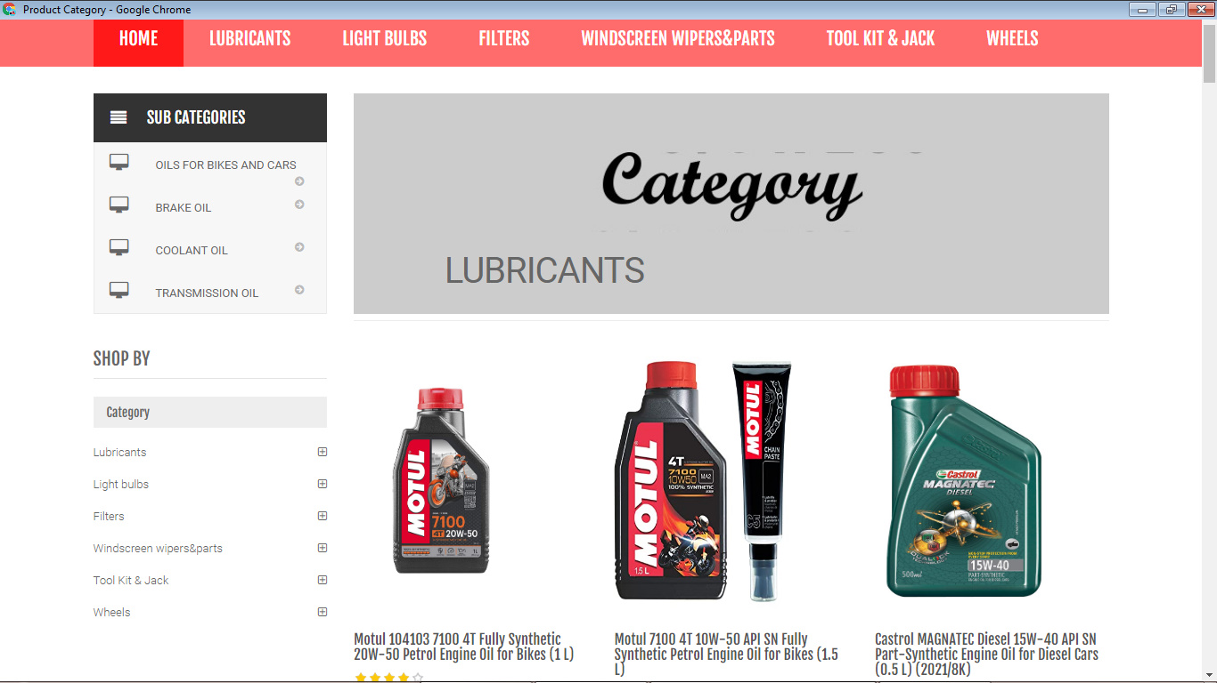
SHOPPING CART PRODUCT PAGE:

Slide 46
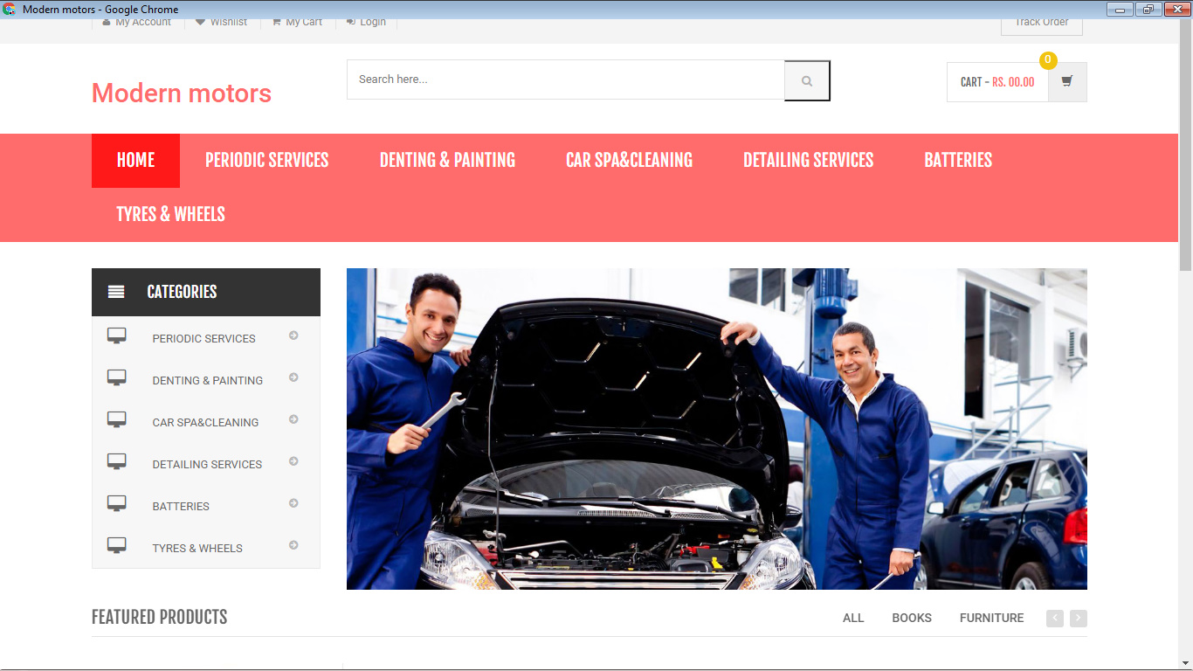
SHOPPING CART SERVICE PAGE:

Slide 47
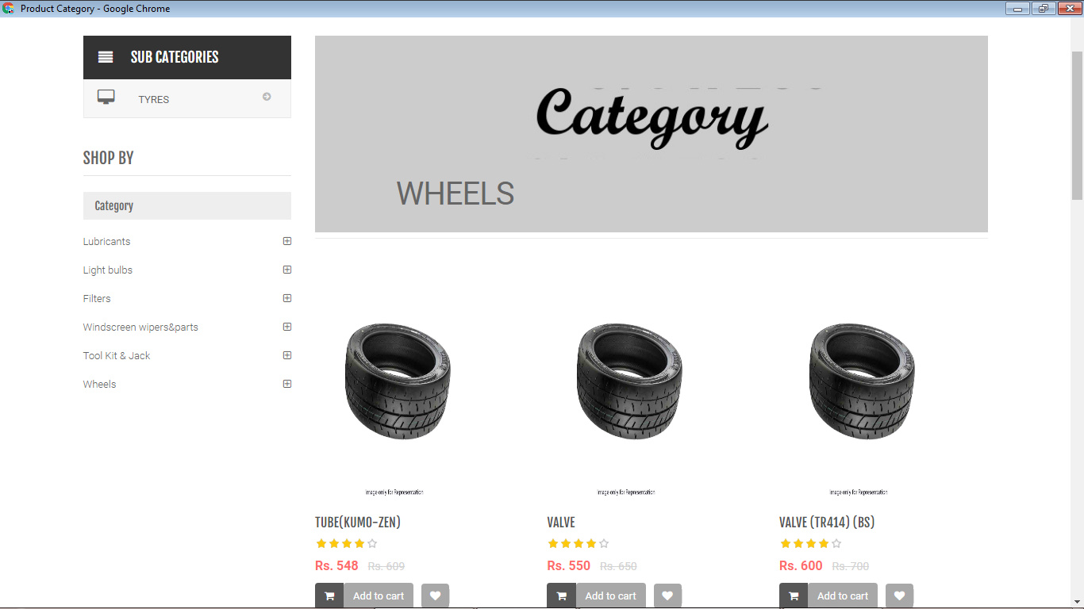
CATEGORY PAGE:

Slide 48
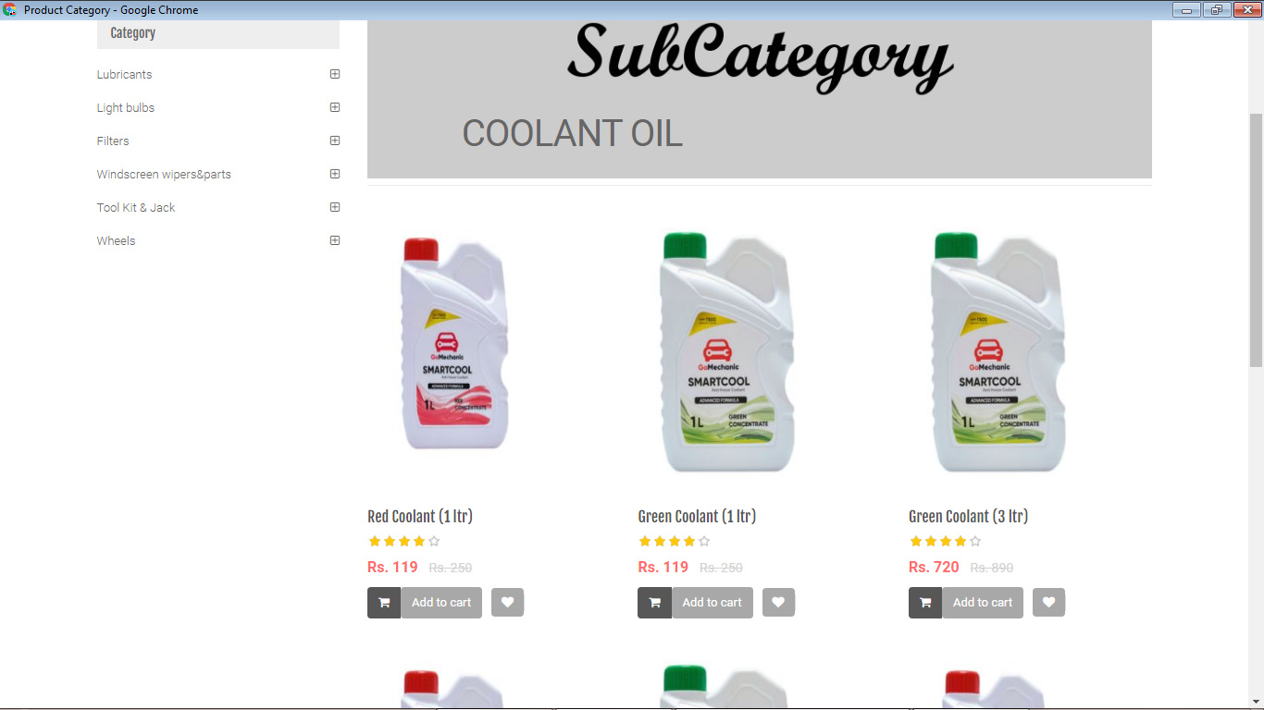
SUBCATEGORY PAGE:

Slide 49
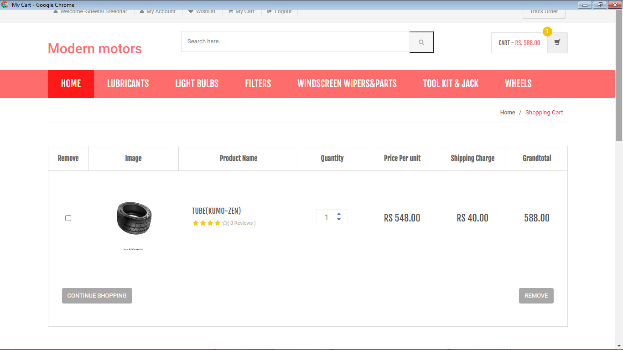
MY CART PAGE:

Slide 50
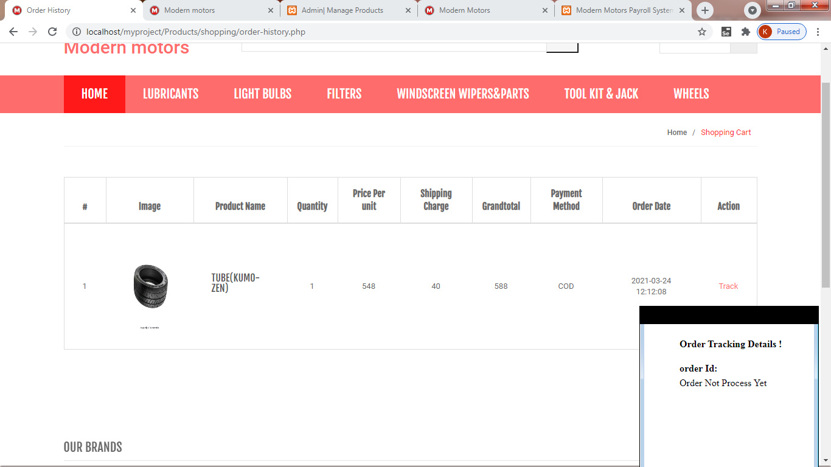
ORDER DETAILS PAGE:

Slide 51
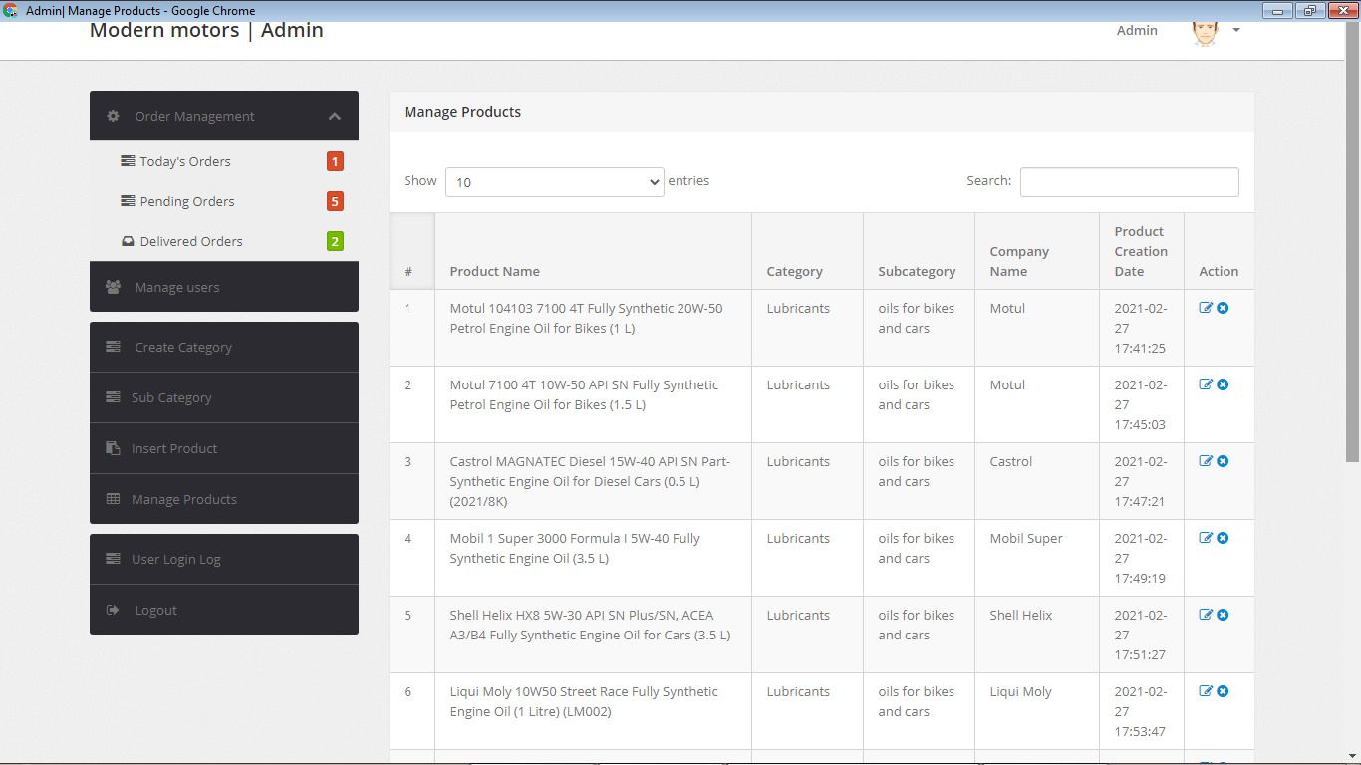
ADMIN SIDE FOR INSERTING PRODUCTS AND SERVICES:

Slide 52
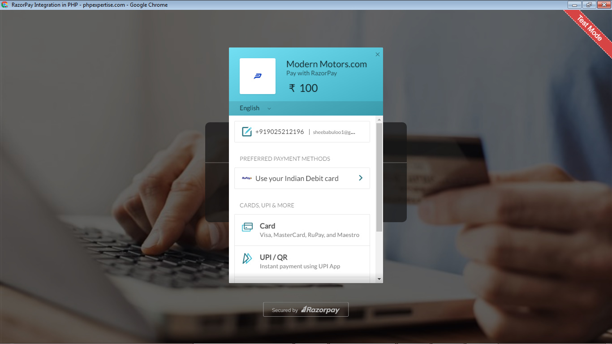
PAYMENT PAGE:

Slide 53
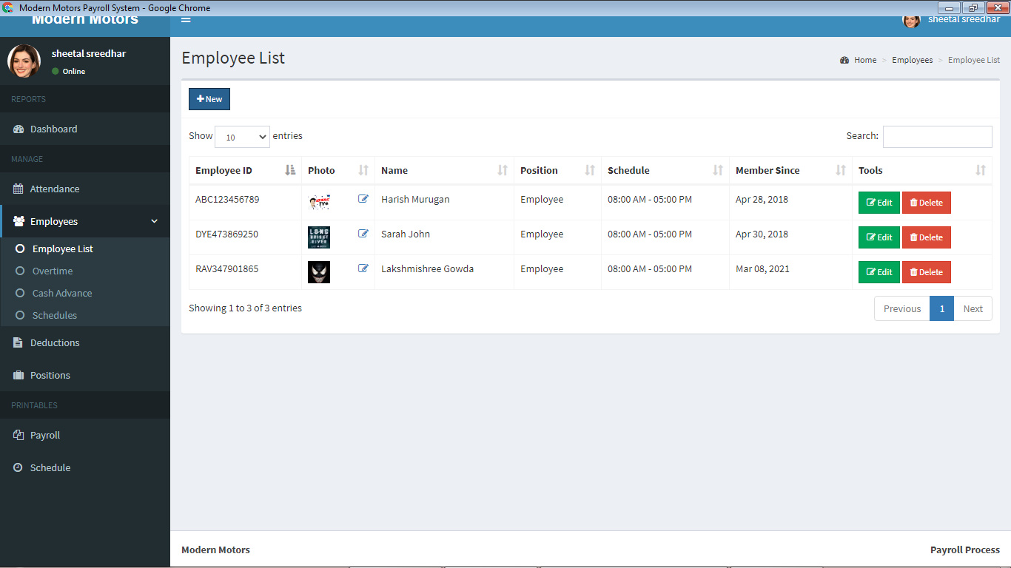
PAYROLL PROCESS
EMPLOYEE LIST PAGE:

Slide 54
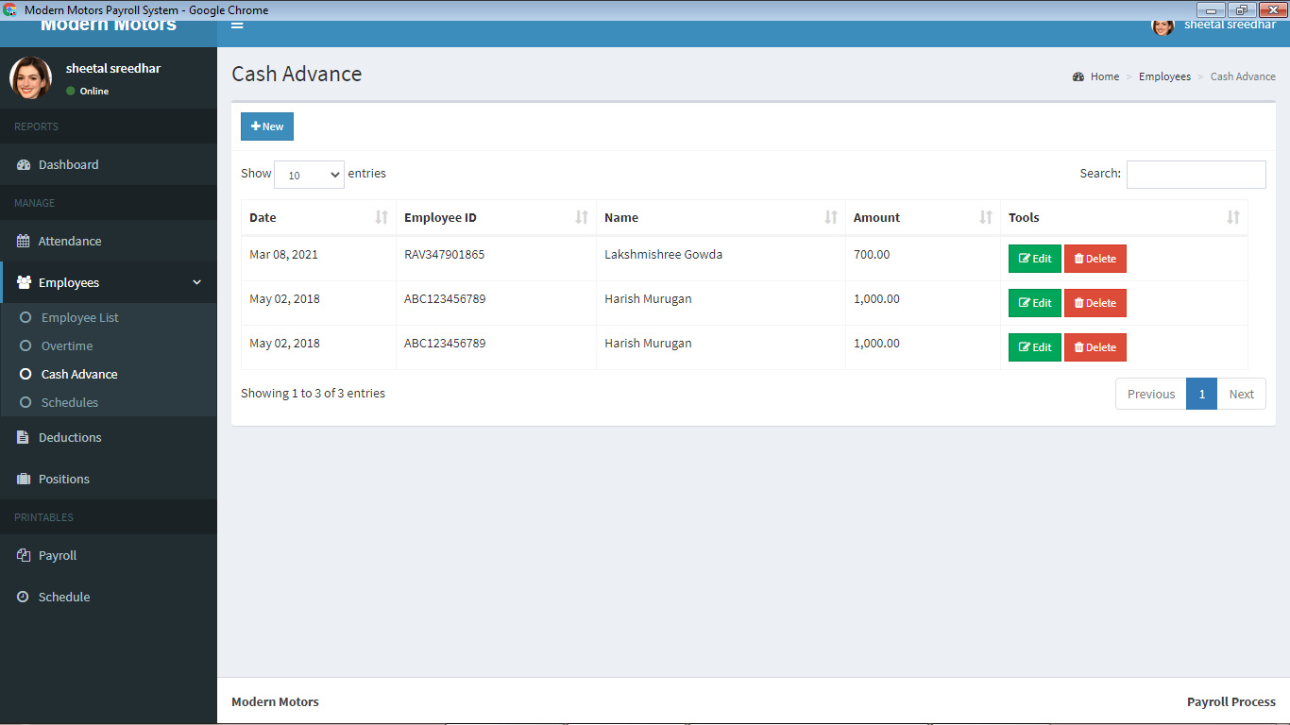
CASH ADVANCE PAGE:

Slide 55
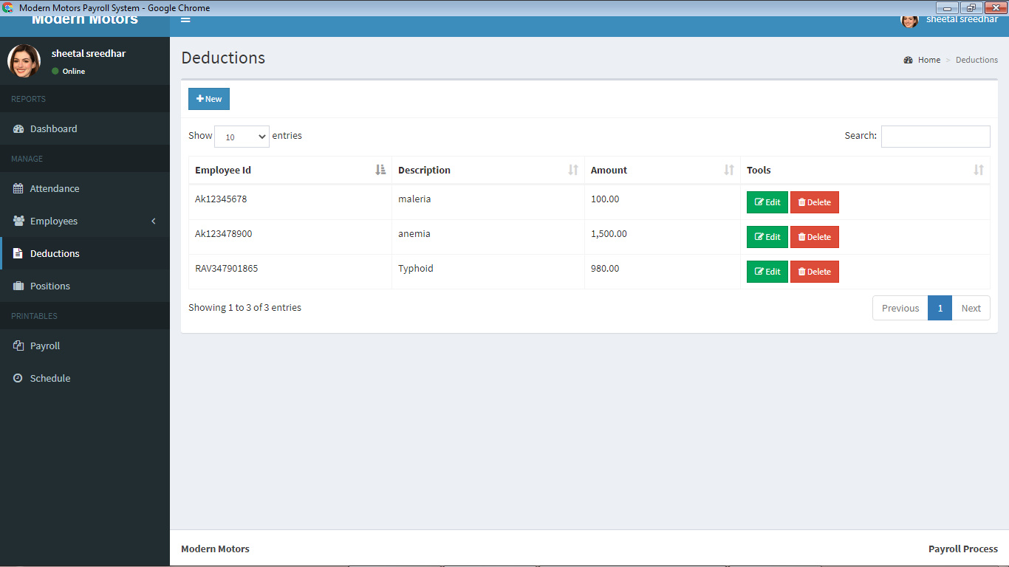
DEDUCTION PAGE:

Slide 56
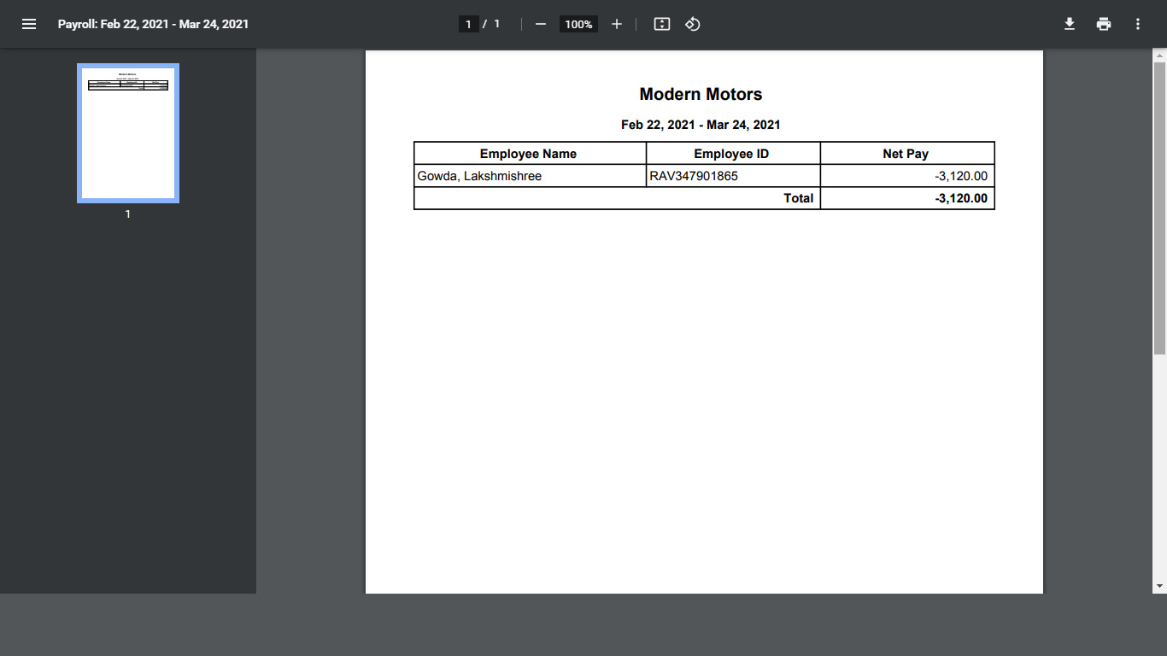
PAYROLL PAGE:

Slide 57
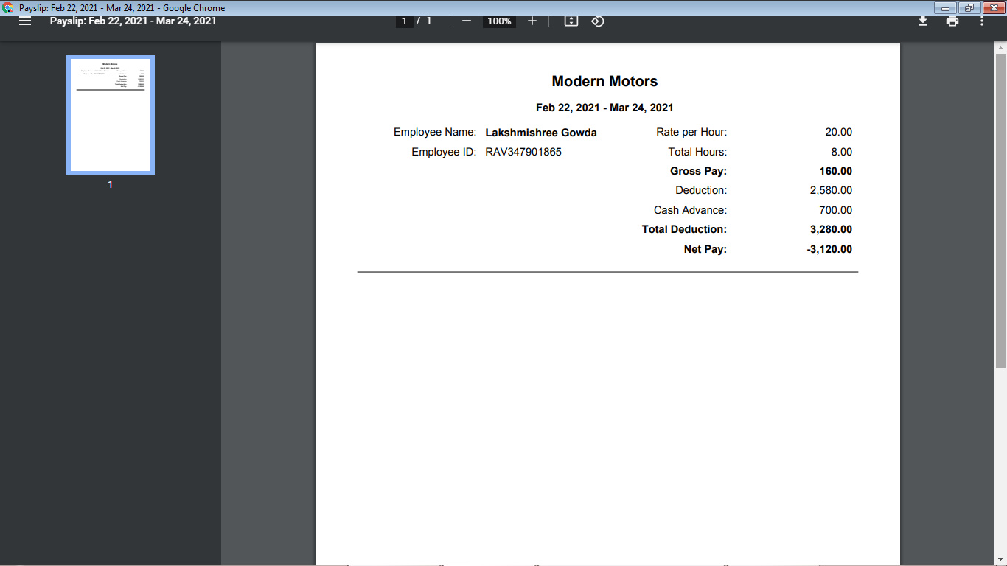
PAYSLIP PAGE:

Slide 58
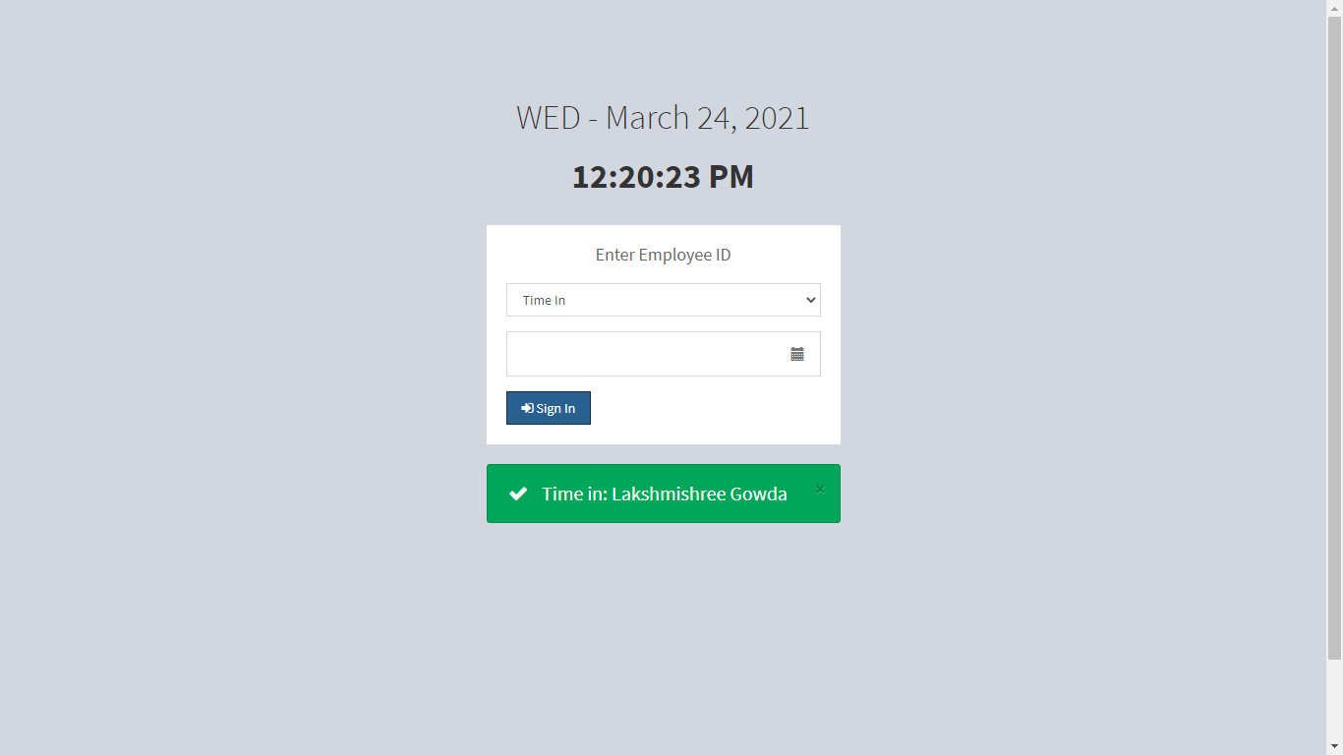
TIMEIN AND TIMEOUT OF EMPLOYEE PAGE:

Slide 59
PERFORMANCE AND LIMITATIONS:
PERFORMANCE:
This application provides greater efficiency to the customers so that they can enhance the features in the application. This website contains better compatibility and security which will be user friendly to the customers. This application provides reduced cost to the customers. It is also time consuming. The employees will deal with the customers in easy and a comfortable manner. Users information will be maintained in a securable port.
MERITS OF THE SYSTEM:
Provides stock inventory in car accessories such as Filters, Tyres, lubricants…etc.
This website also provides payroll processing for the employees.
Provides services for the customer such as:-
Periodic services
Denting and painting
Car spa and cleaning
Batteries
Detailing services
Tyres and wheels
Cash on delivery is available for the customers after purchasing their products.

Slide 60
LIMITATIONS:
Appropriate tracking is not available in the website for purchased order and services .
There is no applicable customer care service for the customers.
There is no OTP generation for sending SMS to the patients.
FUTURE ENHANCEMENT:
Tracking for purchased order or service with courier delivery details will be available in the website.
There will be a proper customer care service for the customers in case of any queries.
In future there will be OTP generations to send SMS to the customers about the payment and order details.

Slide 61
CONCLUSION:
This project “Modern Motors Service and Payroll Management System” completed by satisfying the required design specifications.
The system provides user-friendly interface which was developed with modular approach. All modules in the system have been tested with valid data and invalid data and all modules working successfully.
Thus the system has fulfilled all the objectives identified and is able to replace the existing system.
The constraints are met and overcome successfully. The system designed as like it was decided in the design phase.
This software has user-friendly screen that enables the user to use without any inconvenience.
This would help the customer to easily interact with the system.

Slide 62
REFERENCES
BOOK REFERENCE:
The Joy of PHP Programming: A Beginner's Guide – by Alan Forbes. ...
PHP & MySQL Novice to Ninja – by Kevin Yank. ...
Head First PHP & MySQL – by Lynn Beighley & Michael Morrison. ...
Learning PHP, MySQL, JavaScript, and CSS: A Step-by-Step Guide to Creating Dynamic Websites – by Robin Nixon.
WEB REFERENCE :
www.w3schools.com
www.mysql.com
www.webreference.com
www.tutorialpoint.com
www.github.com

Slide 63
THE END

